Slide 1

Housekeeping
Module 14 – Advocacy
Please mute yourself if you are not speaking.
Feel free to include your pronouns in your Zoom Name.
Use Zoom reaction tools, chat box, hands up, etc.
Be prepared to have video on at all times; as such, please be appropriately dressed and limit distractions.
Contribute to the conversations out loud and in the chat box.
If someone has already shared what you were going to say, lower your hand and put “agree” in the chat.
Notes:
COORDINATOR
Read out Housekeeping slide.

Slide 2
Expectations
Module 14 – Advocacy
Arrive on time.
Help us create a confidential, non-judgmental space (no screenshots or recordings).
Please keep your phones on silent.
Avoid cross-talk and side-talk.
Learn from each person’s perspective.
Language – please bring new language to us as we recognize that language is ever-changing.
Have fun!
From the group:
[ADD PARTICIPANT ADDITIONS, IF ANY]
Notes:
COORDINATOR
Read out Expectations slide.

Slide 3
Advocacy
Module 14
Notes:
Trainer Manual
Module 14: Advocacy © 2023 PeerWorks
This training program is designed to be accessible to all trainers, and ensure that all participants receive the same quality of education regardless of specific trainers’ background and experience.
This manual is a living document and should be understood as a set of guidelines, not as a fixed script. Feel free to adapt the language to your style of presentation. We also recognize that language is always changing; please update terminology when necessary. The synchronous sessions should be dynamic, engaging experiences.
TRAINER
Welcomes everyone and states the topic of today’s module.

Slide 4
Land Acknowledgement
Module 14 – Advocacy
[ADD TRAINER’S LAND ACKNOWLEDGEMENT HERE]
Notes:
TRAINER’S LAND ACKNOWLEDGEMENT

Slide 5
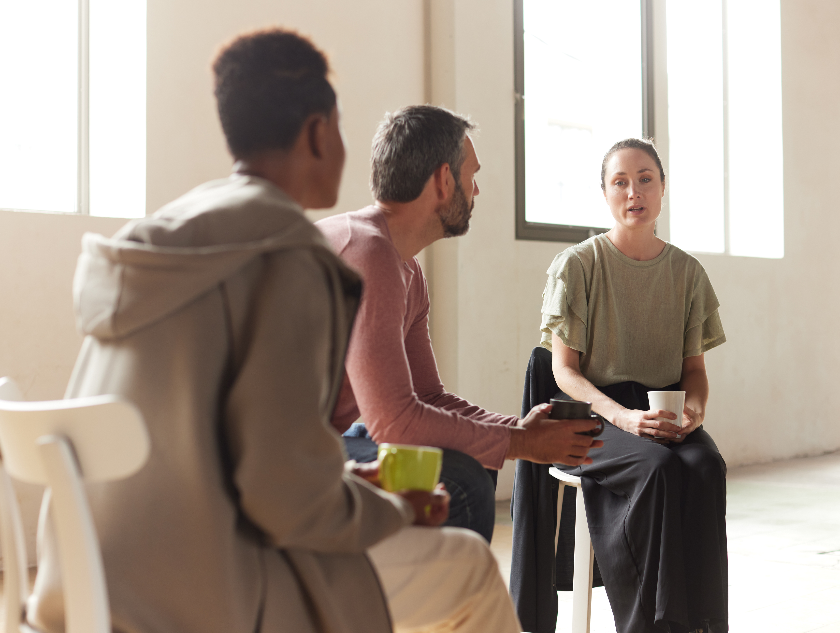
Icebreaker Activity
Module 14 – Advocacy
What is your name?
What is something that you are passionate about?
Notes:
TRAINER
“What is something that you are passionate about?”
As the trainers, feel free to go first. Keep it brief and thank people for sharing.

Slide 6
Module Overview
Module 14 – Advocacy
In Module 14 we will be discussing Advocacy within the Peer Support setting.
We will explore the importance of advocating for the Peers you work with, as well as the significance of Peer Support advocacy on a larger scale. We will also start to develop the skills required for advocacy and discussion scenarios in which we may require them.
This discussion is built off the history of Peer Support that we learned about in Module 3.
Notes:
TRAINER
Read the Module Overview and Learning Objectives out loud or invite a participant to read it out loud.

Slide 7
Learning Objectives
Module 14 – Advocacy
Through the successful completion of Module 14 you will be able to:
Define advocacy and its significance to Peer Support.
Exercise the skills involved in advocacy.
Begin to discover organizations supporting advocacy in your community.
Notes:
TRAINER
Read the Module Overview and Learning Objectives out loud or invite a participant to read it out loud.

Slide 8

Module 14 – Advocacy
What were your thoughts about the homework reading?
What experience do you have with advocacy/self-advocacy?
Notes:
TRAINER
Question about the reading and to open the discussion to advocacy and how familiar people are with it.

Slide 9
Advocacy
Module 14 – Advocacy
Advocacy is any action that speaks in favour of, recommends, argues for a cause, supports or defends, or pleads on behalf of others.
“On behalf of others” is the core component of advocacy. However, in Peer Support, we focus on advocating with others instead of for others. We also encourage people to practice self-advocacy.
Notes:
TRAINER
Ask someone to read out the slide.
“Advocacy can be on a larger level, for instance PeerWorks as an organization does advocacy work with Peer Support organizations across Ontario. We represent their interests at the major provincial mental health/addiction policy planning and strategy implementation tables.
Advocacy can also be on a smaller, more personal level. Peer Supporters can advocate with their Peers and even help their Peers learn how to advocate for themselves.”

Slide 10
Advocacy in Peer Support
Module 14 – Advocacy
Making information accessible
Providing and discussing options
Facilitating decision-making by the individual
Supporting mental health service users to be heard and ensuring that what they say influences the decisions of service providers.
Promoting self-advocacy through empowerment
Ensuring service users are active and informed participants in their treatment and care.
Notes:
TRAINER
Read out the slide or invite someone to read it out. Ask if anyone has anything that they would like to add to the list.

Slide 11
What is self-advocacy?
Module 14 – Advocacy
Self-advocacy is the ability to speak up for yourself and the things that are important to you. Self-advocacy means you can ask for what you need and want and tell people about your thoughts and feelings.
In the Mental Health and Addictions context, this could be being in control of your own wellness plan, working with healthcare practitioners instead of being a passive participant, and breaking down barriers to independence.
This builds on the core Peer Support principles of Self-Determination and Person-Centered Care.
Notes:
TRAINER
Read out the slide or invite someone to read it out. This definition is from (https://selfadvocatenet.com/
You should be halfway through the allotted time now.

Slide 12
Group Discussion Question
Module 14 – Advocacy
In the homework for the History and Social Context Module, Allan Strong asked:
Are we still a social movement, or are we service providers?
How does advocacy work within this question?
Notes:
TRAINER
The discussion questions build on Allan Strong’s presentation on the History and Social Context of Peer Support.

Slide 13
Scenario 1
Group Discussion
Module 14 – Advocacy
In your appointments, Laura has often discussed a difficult relationship with her live-in boyfriend. She didn’t show up yesterday nor return your messages when you called to check in and rebook. Today she comes in with a black eye.
What do you think/feel?
Call the police for Laura.
Talk Laura into going to a shelter for victims of domestic abuse.
Immediately help Laura develop a safety plan.
Ask to meet with Laura and her boyfriend to work things out.
Notes:
TRAINER
This is the first scenario of three. It should be done as a group discussion.
“In your appointments, Laura has often discussed a difficult relationship with her live-in boyfriend. She didn’t show up yesterday nor return your messages when you called to check in and rebook. Today she comes in with a black eye.”
The following questions and bullet points come up one at a time with an animation.
“What do you think/feel?
Call the police for Laura.
Talk Laura into going to a shelter for victims of domestic abuse.
Immediately help Laura develop a safety plan.
Ask to meet with Laura and her boyfriend to work things out.”
Things that might come up in the discussion:
We don’t know that Laura was hit. Ask Laura what happened.
Even though this is a potentially dangerous situation, it is important that Laura retains her agency.
Make sure you don’t betray Laura’s trust, so that she always has a safe place to come back to.
If she decides to stay with her boyfriend, support her. She will still need people to talk to.

Slide 14
Scenario 2
Small Group Discussion
Module 14 – Advocacy
You are working with Andy who tells you he would like to leave the group home and live in his own apartment.
Give Andy the newspaper and help him look for apartments.
Work with Andy to develop a step-by-step plan and budget.
Tell him he is not ready to leave the group home.
Invite him to stay with you to see how he likes apartment living.
*Complication: In the course of your discussion, Andy mentions one of his reasons for wanting to leave is that he keeps getting into arguments with other tenants in his group home, and it’s starting to get physical.
Notes:
TRAINER
This is the second scenario. It can be done in small groups. After five minutes has passed. Send the groups the complication as a broadcast over Zoom.
Come back as a group and discuss how the scenario went. Then get ready to break out again for scenario three.

Slide 15
Skills Practice
Module 14 – Advocacy
Sandy, a peer you have been working with, sees Dr. Thompson, a psychiatrist. She feels that he doesn’t listen to her concerns about some side effects of her medication that have been very uncomfortable for her.
How do you support Sandy in this situation?
Notes:
COORDINATOR
This is the last scenario. It should be done as a skills practice. Ask everyone to break back into their groups. Have one person playing Sandy and the other person playing the Peer Supporter. How do you offer your support?
If there is time:
Use this activity to practice your Skilled Listening.
Use this activity to practice Sharing

Slide 16
For Next Time
Module 14 – Advocacy
Watch the PeerWorks webinar on “Preventing Peer Drift: The Importance of Self-care and Burnout Prevention” by Laura Stanford (55min 33 seconds)
Recommend us a song that makes you happy.
Notes:
COORDINATOR
Read out the homework.

Slide 17
Thank You
Notes:
TRAINER
Thank everyone for their time and ask if anyone has any final comments or questions that they want to bring forward.

